Slide 1
Minor project on Fake News Detection using NLP and LSTM
Ronish Shrestha (KCE075BCT032)
Roshan Shrestha (KCE075BCT033)
Rubin Baidhya (KCE075BCT034)
Sairush Tamang (KCE075BCT036)

Slide 2


background
Incorrect information that might be lies
Spread mostly through social medias
For false promotion and personal gains
Creates trouble and chaos among people and society
Can be solved through AI algorithms

Slide 3

problem
Our main problem is that we do not have enough nepali dataset.
Fake news mislead the readers and create a devastating impact on people's mindset.
It tends to encroach human right and public safety so our priority is to build this system so that real news can be shared to all.

Slide 4
Objectives
Develop a system for recognizing and classifying news stories using NLP and LSTM.
01
The main purpose is to spot fake news.
02
Our goal is to create a model that can determine whether a news piece is phony or real.
03

Slide 5


Feasibility analysis
Time Feasibility
Space Feasibility
Technical Feasibility
Economic Feasibility
Operational Feasibility

Slide 6
software requirements
Python
Keras
NLP
RNN
LSTM

Slide 7
Natural language processing (NLP)
Concerned with interactions between computer and human language.
Enables computer to analyze and understand human language.
A difficult problem in computer science.
Based in machine learning algorithms.
Spell check, Autocomplete, Siri/Alexa/Google assistant

Slide 8
Recurrent Neutral network (rnn)
Type of artificial neural network.
Uses sequential data or time series data.
Recognizes data's sequential characteristics and use patterns to predict the next likely scenario.
Used in deep learning and in the development of models that simulate neuron activity in the human brain.
Image captioning, Natural Language Processing, Machine translation

Slide 9
Long short term memory (lstm)
A deep learning architecture that uses an artificial recurrent neural network (RNN).
Can handle not only individual data points(such as photos), but also unsegmented, connected handwriting identification, speech recognition, and anomaly detection in network traffic or IDS (intrusion detection systems) can all benefit from LSTM.
A cell, an input gate, an output gate, and a forget gate make up a typical LSTM unit.
The three gates control the flow of information into and out of the cell, and the cell remembers values across arbitrary time intervals.

Slide 10
FUnctional Requirement
Adaptable and elaborated from the point of view of the users.
Able to distinguish the types of news content.
Should figure out the news that are completely fake or not genuine.

Slide 11
Non-functional requirements
Reliability
Maintainability
Performance
Accuracy

Slide 12
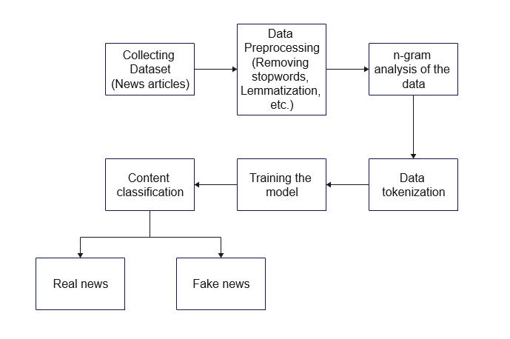
Overview
System Block Diagram

Slide 13
methodology
Data collection
Dataset processing
N-gram analysis
Modelling
Software development approach

Slide 14

Data Collection
Datasets are collected from:
1.Kaggle
2. Buzz Feed News (was created with the help of Facebook and, is fact-checked by five Buzzfeed journalists.)

Slide 15
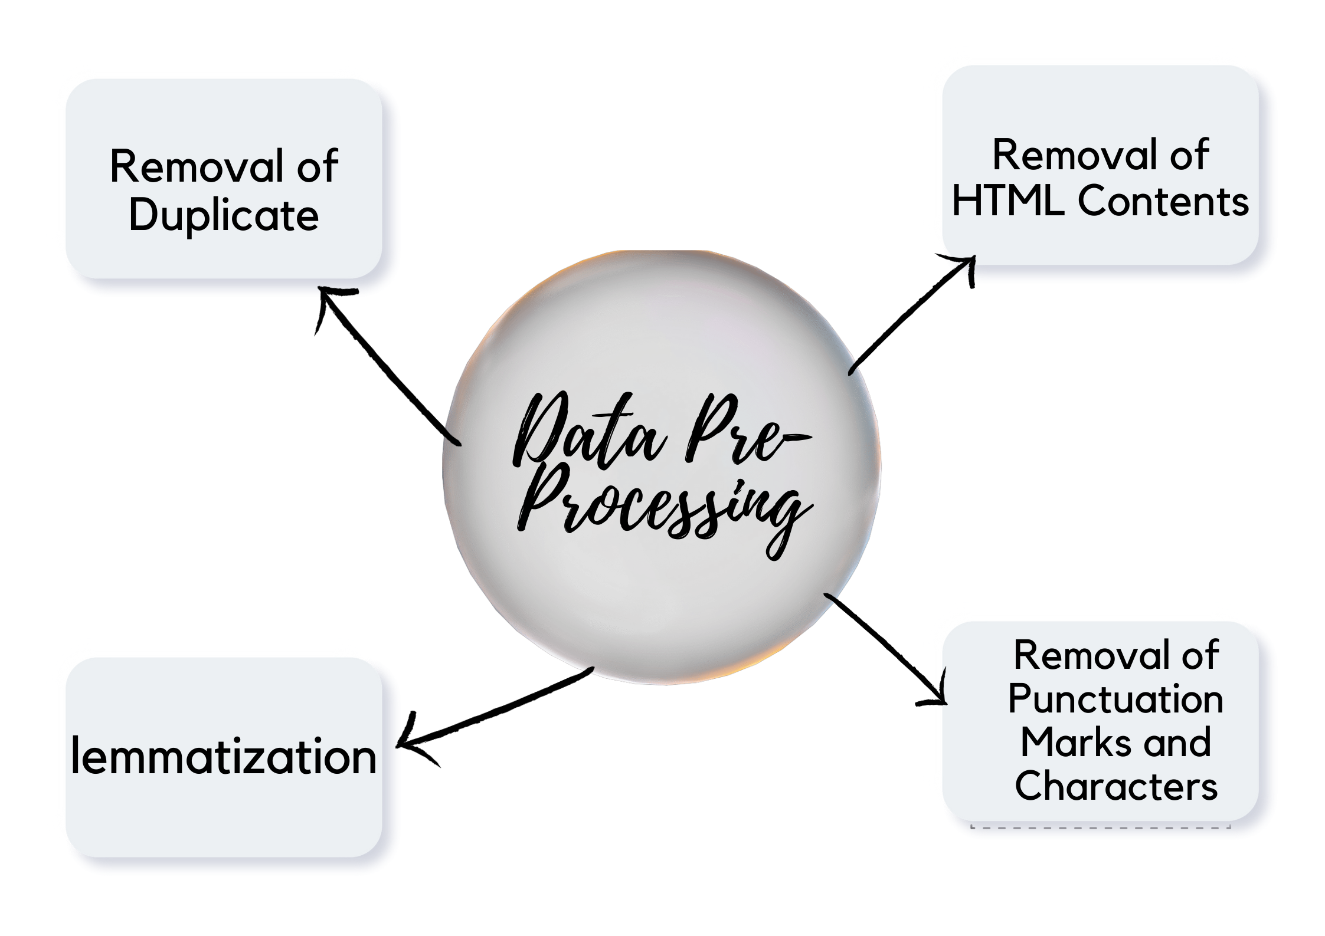
Dataset Pre-Processing

Slide 16
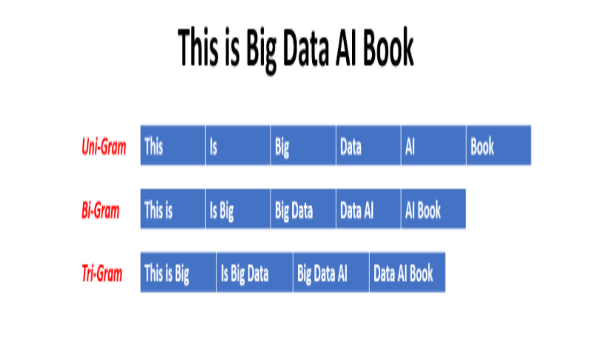
N-Gram Analysis

Slide 17
Modelling

Slide 18
Tools used
Python
Google Collab
Jupyter Notebook
Visual Studio Code
Git-Hub

Slide 19
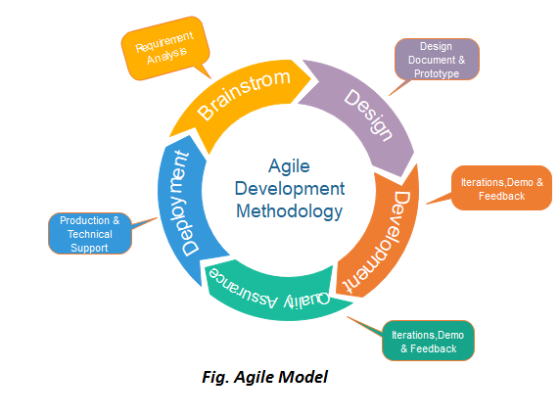
Agile Software Development approach

Slide 20
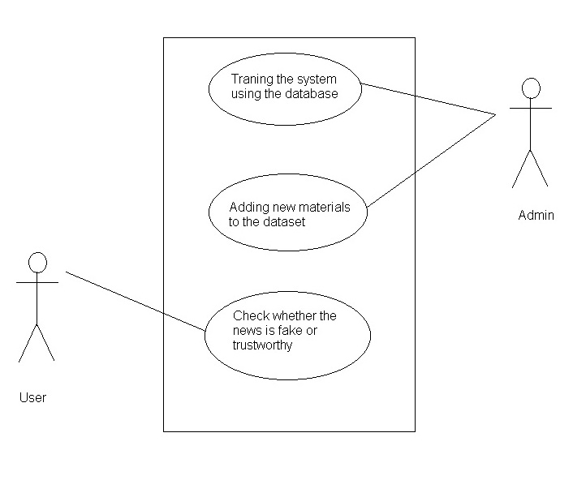
Use case diagram

Slide 21
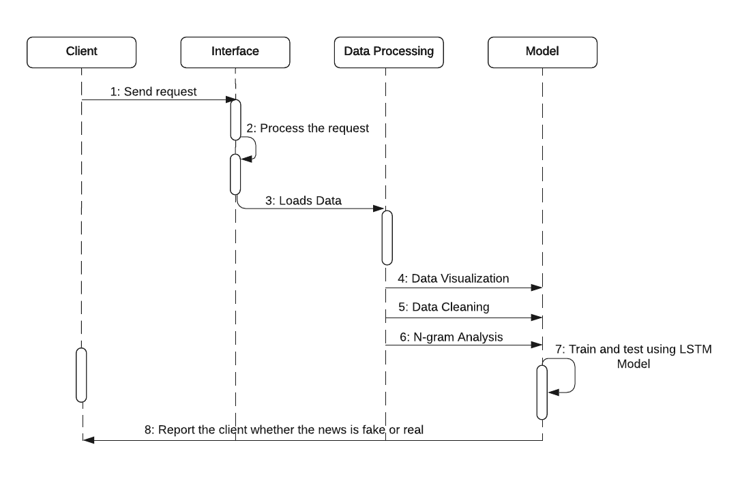

sequence diagram

Slide 22
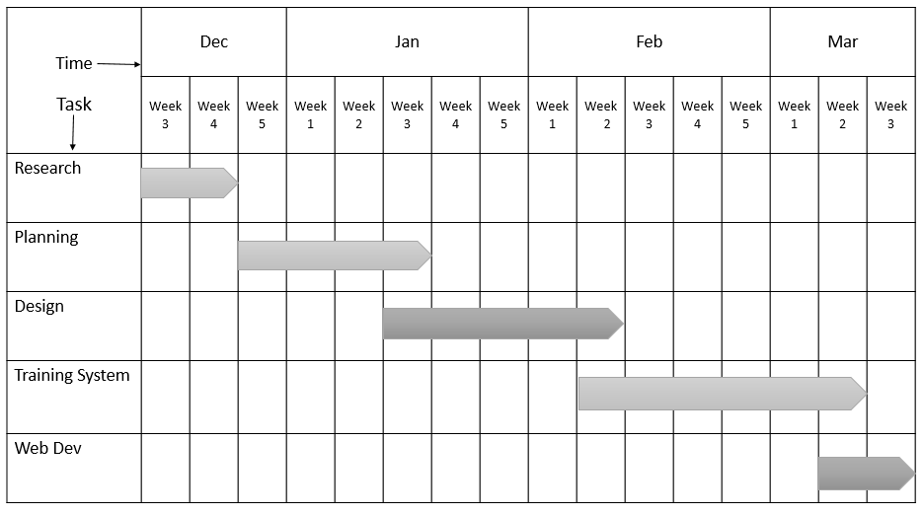
Gantt-chart

Slide 23

implementation
Social Media
Compare the unverified news with real news
Fact Checking

Slide 24
Scope
Help in minimizing spread of disinformation
Protect people's right to true information
Identify real news from fake news

Slide 25
limitations
We won't be able to guarantee that our project will be completely accurate.
System won't be able to detect the fake news if the dataset for the article isn't addressed while training the mode.
Our system will not be able to determine whether an image is genuine or not.

Slide 26
Future enhancements
Newer and more efficient deep learning algorithms can be used.
Identification of fake news through images can be implemented.
The system can be developed for mobile applications.

Slide 27
conclusion
We have used NLP and LSTM along with N-grams to implement FAKE NEWS DETECTION.
The project will be able to detect fake news.

Slide 28
references
[1] Mohammad-Ali Abbasi and Huan Liu. “Measuring User Credibility in Social Media”. In:Social Computing, Behavioral-Cultural Modeling and Prediction. Ed. by Ariel M. Green-berg, William G. Kennedy, and Nathan D. Bos. Berlin, Heidelberg: Springer Berlin Hei-delberg, 2013, pp. 441–448.isbn: 978-3-642-37210-0.
[2] Hadeer Ahmed, Issa Traore, and Sherif Saad. “Detecting opinion spams and fake newsusing text classification”. In:Security and Privacy1.1 (2018), e9.
[3] Pritika Bahad, Preeti Saxena, and Raj Kamal. “Fake News Detection using Bi-directionalLSTM-Recurrent Neural Network”. In:Procedia Computer Science165 (2019). 2nd Inter-national Conference on Recent Trends in Advanced Computing ICRTAC -DISRUP - TIVINNOVATION , 2019 November 11-12, 2019, pp. 74–82.issn: 1877-0509.doi:https://doi.org/10.1016/j.procs.2020.01.072.url:https://www.sciencedirect.com/science/article/pii/S1877050920300806.
[4] Shlok Gilda. “Notice of Violation of IEEE Publication Principles: Evaluating machinelearning algorithms for fake news detection”. In:2017 IEEE 15th Student Conference onResearch and Development (SCOReD). 2017, pp. 110–115.doi:10.1109/SCORED.2017.8305411.
[5] Mykhailo Granik and Volodymyr Mesyura. “Fake news detection using naive Bayes clas-sifier”. In:2017 IEEE First Ukraine Conference on Electrical and Computer Engineering(UKRCON). 2017, pp. 900–903.doi:10.1109/UKRCON.2017.8100379.
[6] Kaggle. “Fake News Kaggle Dataset. [Online]. Available: https://www.kaggle.com/c/fake-news/data?select=train.csv”. In: (2020).
[7] Rohit Kumar Kaliyar. “Fake news detection using a deep neural network”. In:2018 4thInternational Conference on Computing Communication and Automation (ICCCA). IEEE.2018, pp. 1–7.
[8] Rohit Kumar Kaliyar et al. “FNDNet–a deep convolutional neural network for fake newsdetection”. In:Cognitive Systems Research61 (2020), pp. 32–44.
[9] Buzzfeed News. “Buzzfeed News Dataset. [Online]. Available: https://github.com/BuzzFeedNews/2016-10-facebook-fact-check/tree/master/data”. In: ().
[10] Ray Oshikawa, Jing Qian, and William Yang Wang. “A survey on natural language pro-cessing for fake news detection”. In:arXiv preprint arXiv:1811.00770(2018).
[11] Muhammad Umer et al. “Fake news stance detection using deep learning architecture(CNN-LSTM)”. In:IEEE Access8 (2020), pp. 156695–156706.

Slide 29

THANK YOU

